Slide 1

1D Array C++
PEMROGRAMAN KOMPUTER
DEPARTEMEN STATISTIKA
FSAD ITS

Slide 2
ARRAYS
Example :
- product part numbers :
int part_number[4] = {123, 326, 178, 1209};
- student scores:
int scores[10] = {1, 3, 4, 5, 1, 3, 2, 3, 4, 4};
- characters:
char alphabet[5] = {‘A’, ‘B’, ‘C’, ‘D’, ‘E’}
an array is a collection of variables of the same type that are referred to by a common name
Arrays offer a convenient means of grouping together several related variables, in one dimension or more dimentions

Slide 3
One Dimentional Arrays
A one-dimentional array is a list of related variables. The general form of a one-dimentional array declaration is:
type variable_name[size]
- type : base type of array, determines the data type of each element in the array
- size : how many elements the array will hold
- variable_name : the name of the array
Ex :
int sample[10];
float x[100];
char last_name[40];

Slide 4
Accessing Array Elements
An individual element within an array is accessed by use of an index. An index describe the position of an element within an array.
Note: in C++ the first element has the index zero

Slide 5
Representation of Array in Memory
In C++, any array is mapped to a contiguous memory location. All memory elements reside next to each other. The lowest address corresponds to the first element, and the highest address to the last element.

Slide 6
No Array to Array Assignments
You cannot assign one array to another in C++
Ex : assign all elements of array b to array a
int a[10], b[10];
a=b //the following is illegal
instead, you have do the assignment for each element:
int i;
for(i=0; i<10, i++) a[i] = b[i];

Slide 7
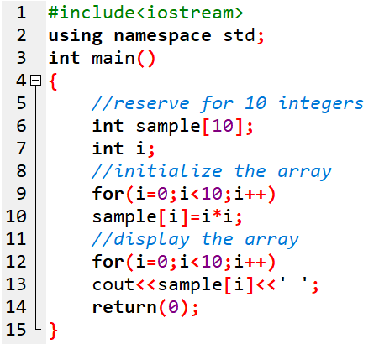
Example :

Slide 8
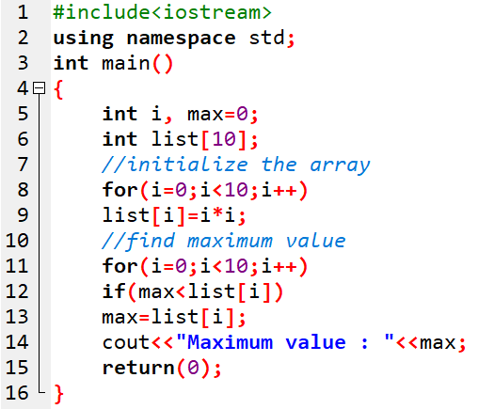
Example : Program untuk mencari nilai maksimum

Slide 9
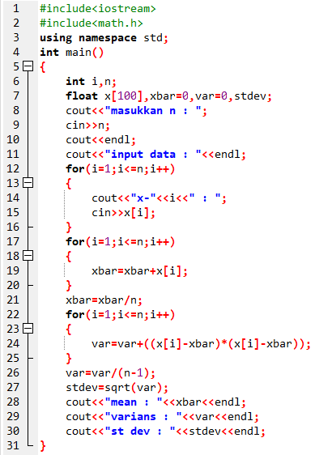
Latihan : Buat program menghitung nilai mean,
varians, dan standar deviasi

Slide 10
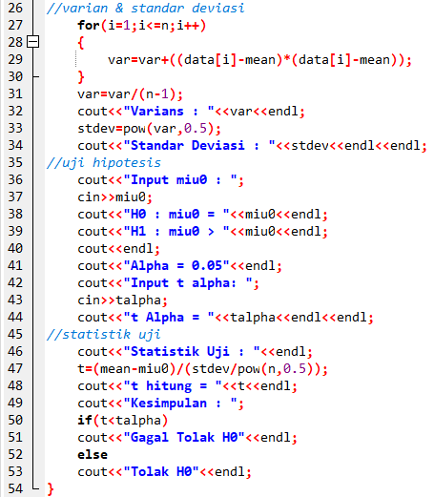
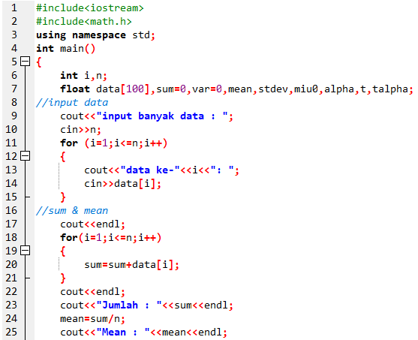
Latihan : Buat program uji t untuk rata-rata 1 populasi

Slide 11
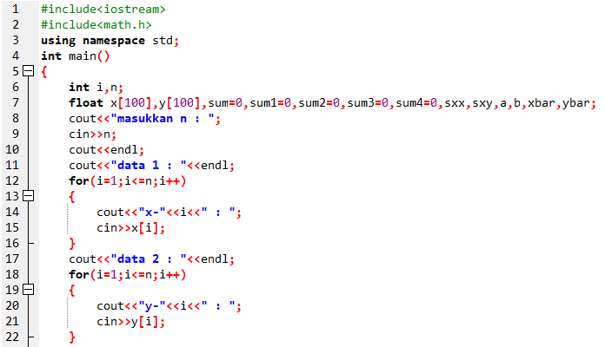
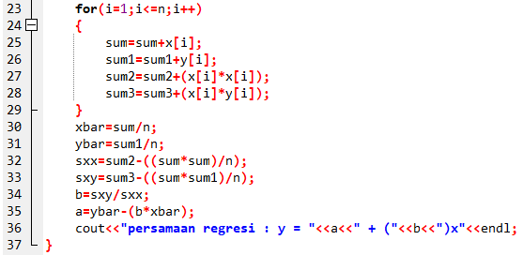
Latihan : Buat program persamaan regresi linear sederhana

Slide 12
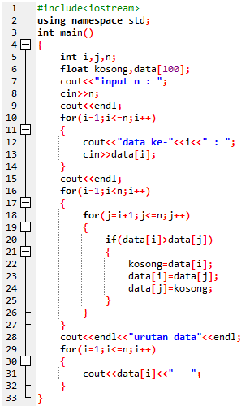
Latihan : Buat program mengurutkan data (sort) dari terkecil ke data terbesar

Slide 13
Practice :
Buat program untuk mencari nilai korelasi dan kovarians dari 2 variabel x dan y
Buat program deret bilangan dengan batas suatu bilangan n yang diinput oleh user
Bilangan prima sebelum bilangan n
Contoh: jika n=10 maka, deret bilangan prima : {2, 3, 5, 7}
Bilangan fibonacci pertama sebanyak n
Contoh: jika n=10 maka, deret bilangan fibonacci : {0, 1, 1 , 2, 3, 5, 8, 13, 21, 34}

Slide 14
Practice :
1. Mean, varians, stdev
2. Uji t 1 sampel
3. Regresi linear sederhana
Note : Latihan diatas diupload juga di link gdrive intip.in/M13ProkomC folder Praktikum dengan format NRP_Nama

